Slide 1
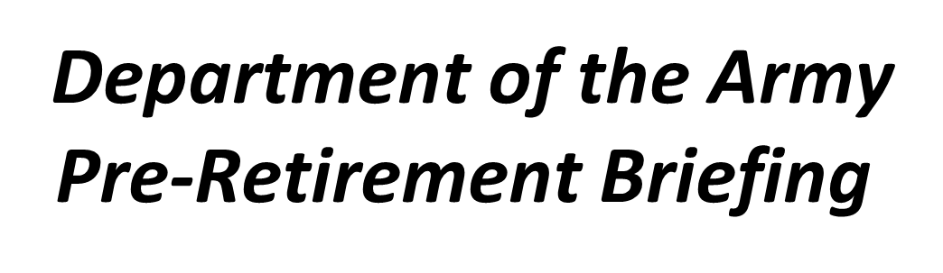
PRE-RETIREMENT BENEFIT BRIEFING
We are the Army's Home
#LifeisBetteratBenning

Slide 2
PRE-RETIREMENT BENEFIT BRIEFING
ATTENTION
This presentation is only for Soldiers who are 12 months out from retirement date beginning 23 March 2020. Soldiers 90 days outside 12 month retirement window must physically attend a mandatory briefing once COVID-19 restrictions have ended. Please do not use these slides for soldiers with a retirement date after 10 May 2021. Additional provisions will be made as needed.
We are the Army's Home
#LifeisBetteratBenning

Slide 3
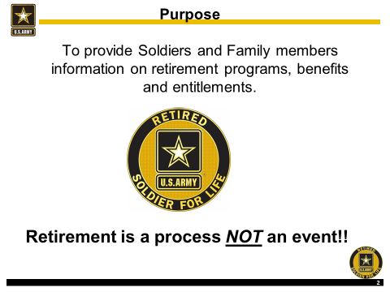
PRE-RETIREMENT BENEFIT BRIEFING
We are the Army's Home
#LifeisBetteratBenning

Slide 4


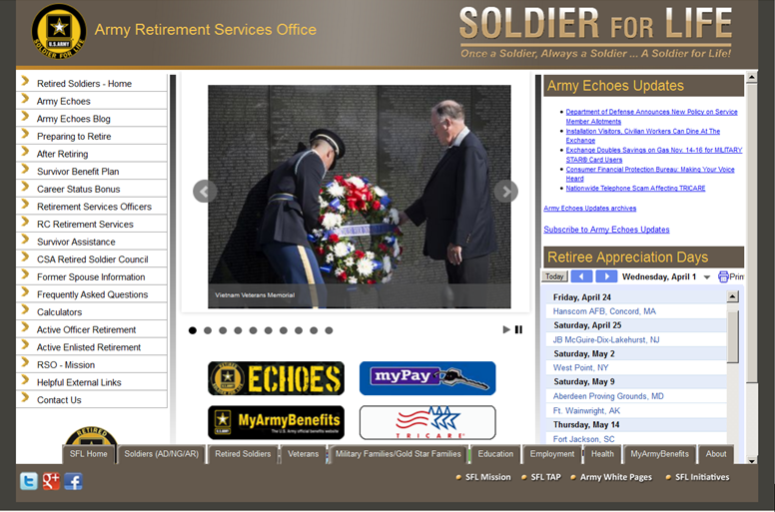
PRE-RETIREMENT BENEFIT BRIEFING
We are the Army's Home
#LifeisBetteratBenning

Slide 5
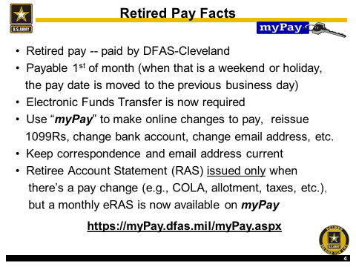
PRE-RETIREMENT BENEFIT BRIEFING
We are the Army's Home
#LifeisBetteratBenning

Slide 6

PRE-RETIREMENT BENEFIT BRIEFING
We are the Army's Home
#LifeisBetteratBenning

Slide 7
PRE-RETIREMENT BENEFIT BRIEFING
Allotments
In retirement, permitted to have:- 6 “discretionary”
You can have an unlimited amount of “non-discretionary” allotments.
For recalled Soldiers at retirement:
- NONE continue from active duty
- ALL must be re-initiated after separation
WHY? DFAS-CL has no interface with DFAS-IN
Allotments except the Combined Federal Campaign (CFC), Veterans Educational Assistance Program (VEAP), and Servicemember’s Group Life Insurance (SGLI) will continue into retirement unless stopped by the Soldier.
At least 30 days prior to the date of your retirement, you should review your Active Duty myPay account, and make sure you have established all the allotments you would like to carry over with you into retirement.
It is important to verify that your retirement pay will be sufficient to cover all your allotments. Some adjustment in amounts may be necessary to accommodate your Retired Pay without having a negative impact on your pay.
Can start/stop/change via myPay @ https://myPay.dfas.mil
More information at:
http://www.dfas.mil/retiredmilitary/manage/allotments.html
We are the Army's Home
#LifeisBetteratBenning

Slide 8

PRE-RETIREMENT BENEFIT BRIEFING
We are the Army's Home
#LifeisBetteratBenning

Slide 9
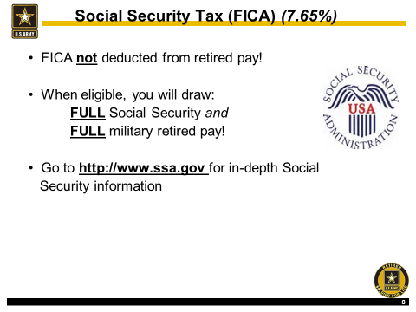
PRE-RETIREMENT BENEFIT BRIEFING
We are the Army's Home
#LifeisBetteratBenning

Slide 10
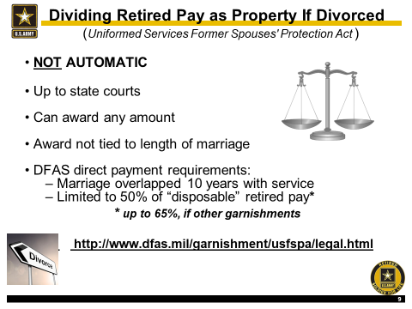
PRE-RETIREMENT BENEFIT BRIEFING
We are the Army's Home
#LifeisBetteratBenning

Slide 11
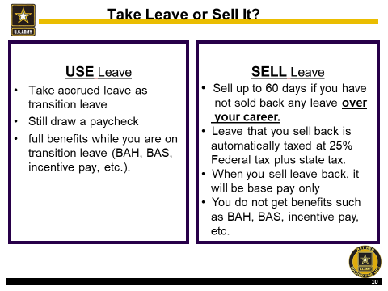
PRE-RETIREMENT BENEFIT BRIEFING
We are the Army's Home
#LifeisBetteratBenning

Slide 12
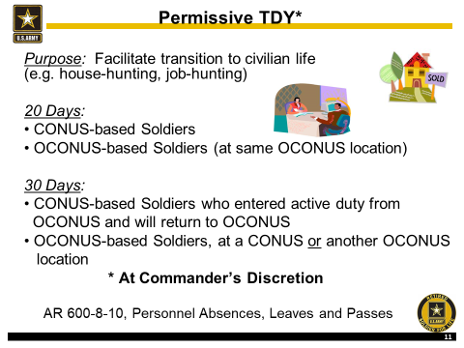
PRE-RETIREMENT BENEFIT BRIEFING
We are the Army's Home
#LifeisBetteratBenning

Slide 13
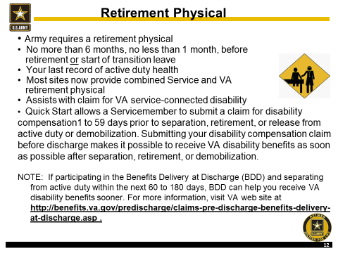
PRE-RETIREMENT BENEFIT BRIEFING
We are the Army's Home
#LifeisBetteratBenning

Slide 14
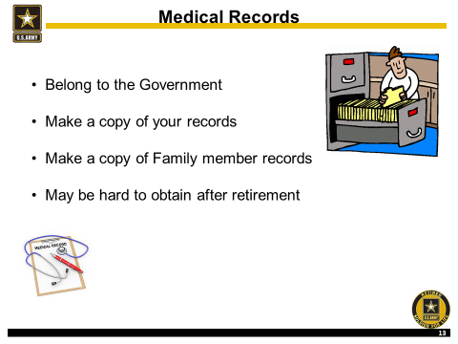
PRE-RETIREMENT BENEFIT BRIEFING
We are the Army's Home
#LifeisBetteratBenning

Slide 15
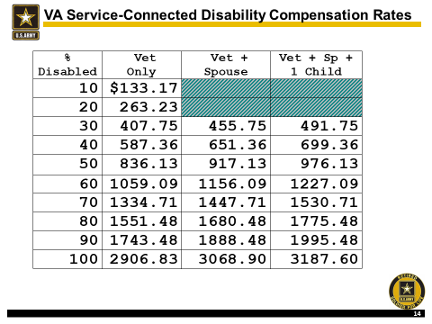
PRE-RETIREMENT BENEFIT BRIEFING
We are the Army's Home
#LifeisBetteratBenning

Slide 16

PRE-RETIREMENT BENEFIT BRIEFING
We are the Army's Home
#LifeisBetteratBenning

Slide 17
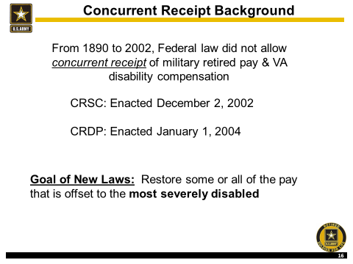
PRE-RETIREMENT BENEFIT BRIEFING
We are the Army's Home
#LifeisBetteratBenning

Slide 18
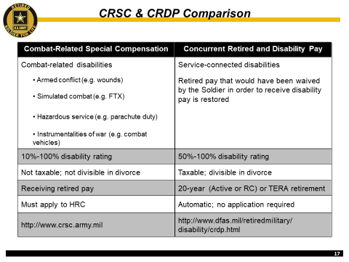
PRE-RETIREMENT BENEFIT BRIEFING
We are the Army's Home
#LifeisBetteratBenning

Slide 19
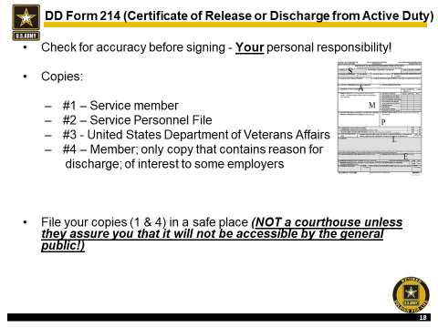
PRE-RETIREMENT BENEFIT BRIEFING
We are the Army's Home
#LifeisBetteratBenning

Slide 20
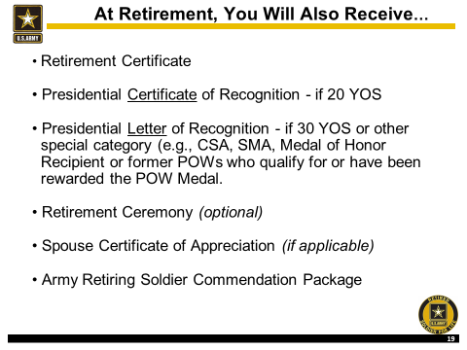
PRE-RETIREMENT BENEFIT BRIEFING
We are the Army's Home
#LifeisBetteratBenning

Slide 21
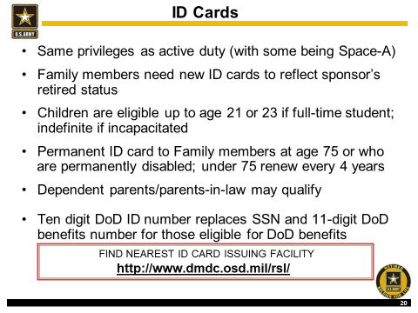
PRE-RETIREMENT BENEFIT BRIEFING
We are the Army's Home
#LifeisBetteratBenning

Slide 22
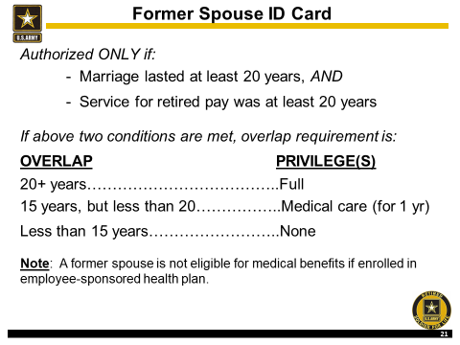
PRE-RETIREMENT BENEFIT BRIEFING
We are the Army's Home
#LifeisBetteratBenning

Slide 23

PRE-RETIREMENT BENEFIT BRIEFING
We are the Army's Home
#LifeisBetteratBenning

Slide 24

PRE-RETIREMENT BENEFIT BRIEFING
We are the Army's Home
#LifeisBetteratBenning

Slide 25
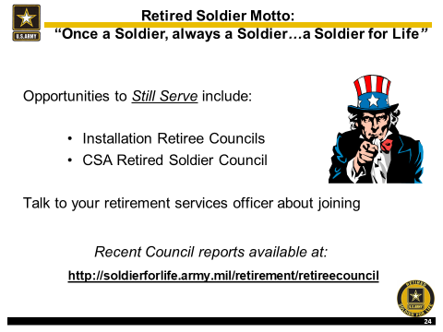
PRE-RETIREMENT BENEFIT BRIEFING
We are the Army's Home
#LifeisBetteratBenning

Slide 26
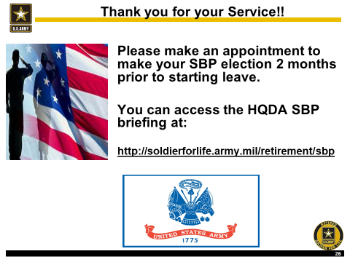
PRE-RETIREMENT BENEFIT BRIEFING
We are the Army's Home
#LifeisBetteratBenning

Slide 27
PRE-RETIREMENT BENEFIT BRIEFING
Retirement Services Office (RSO), Point of Contact
RSO: Mrs. Clemons – (706) 545-1805
Alternate RSO: Mrs. Colson – 545-4434
SBP Counselor: Ms. Harris – 545-2715
Analyst Clerk: Mrs. Marshall – 545-1738
Analyst Clerk: Ms. Jenkins – 545-1828
We are the Army's Home
#LifeisBetteratBenning

Slide 28
PRE-RETIREMENT BENEFIT BRIEFING
I have viewed Pre-Retirement Benefit slides
PRINT NAME:________________________________
SIGNATURE: ________________________________
DATE: ______________________________________
Please print signature page and email to: usarmy.benning.imcom.mbx.glhrd-rso@mail.mil
Once you have viewed both Survivor Benefit and Pre-Retirement Benefit slides, please email the signature pages to the above email address. You will not receive your DA form 2339 (computation sheets, enlisted only) to sign until both signature pages are received.
We are the Army's Home
#LifeisBetteratBenning

